Slide 1


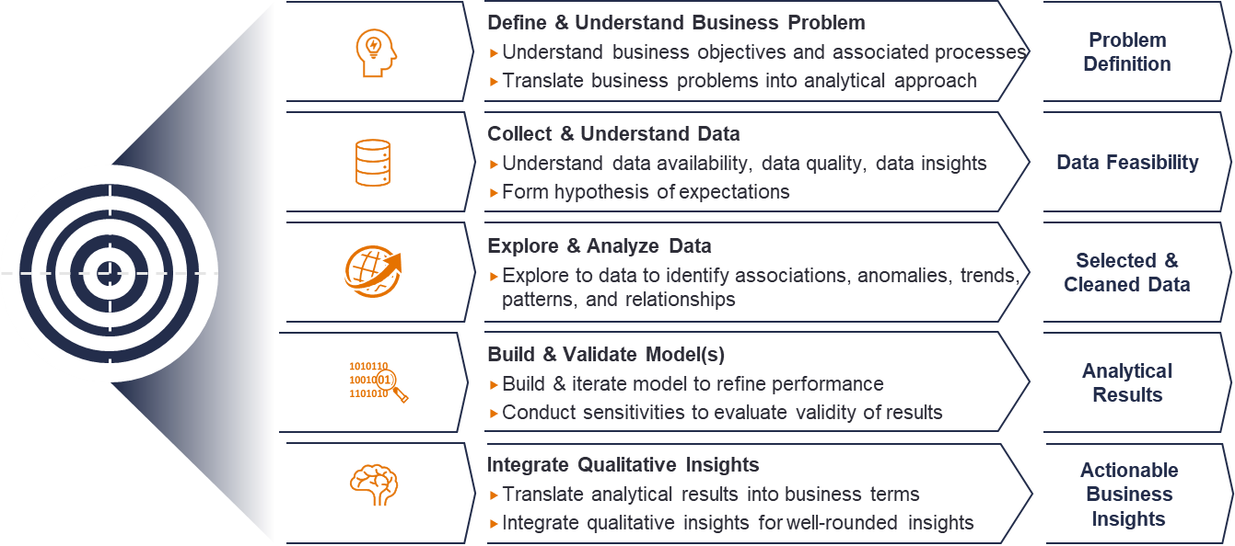
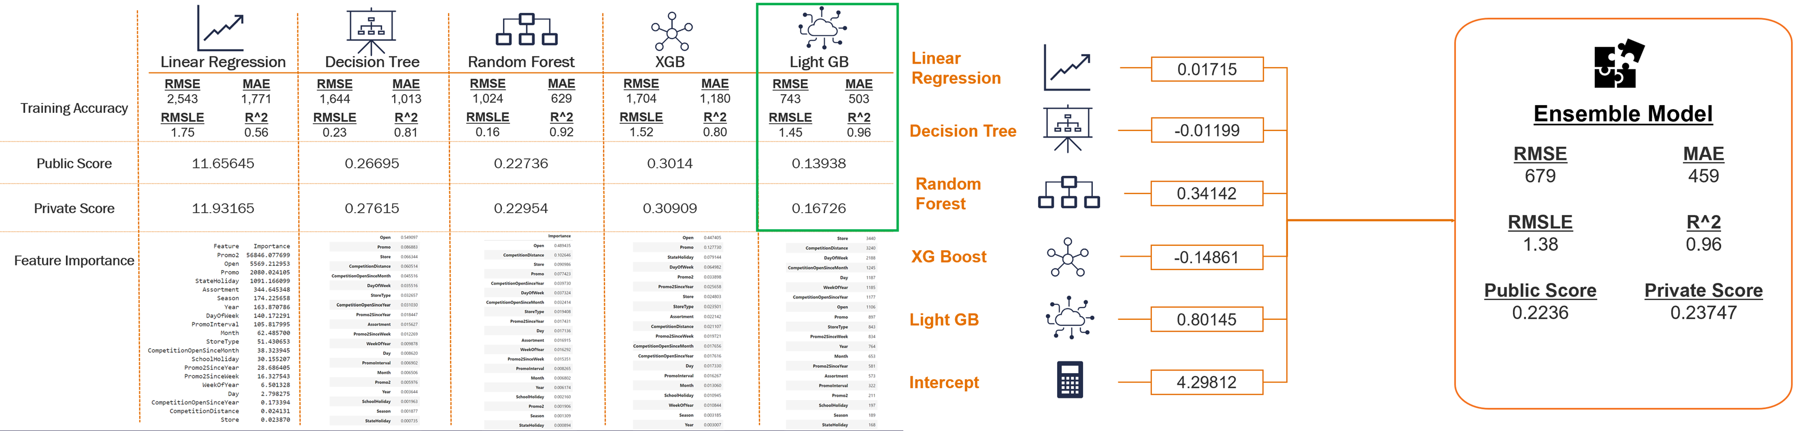
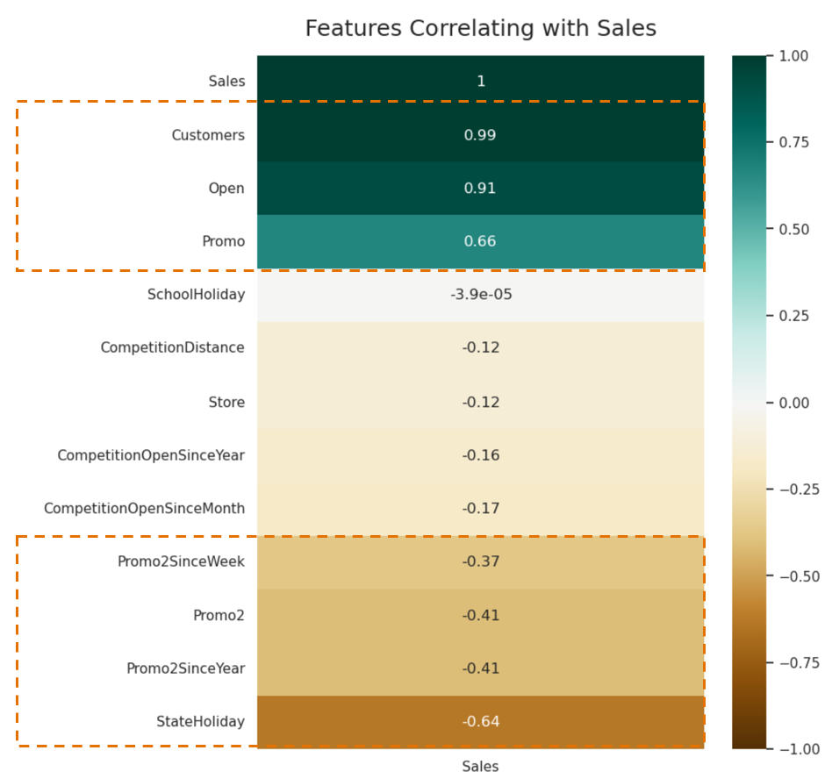
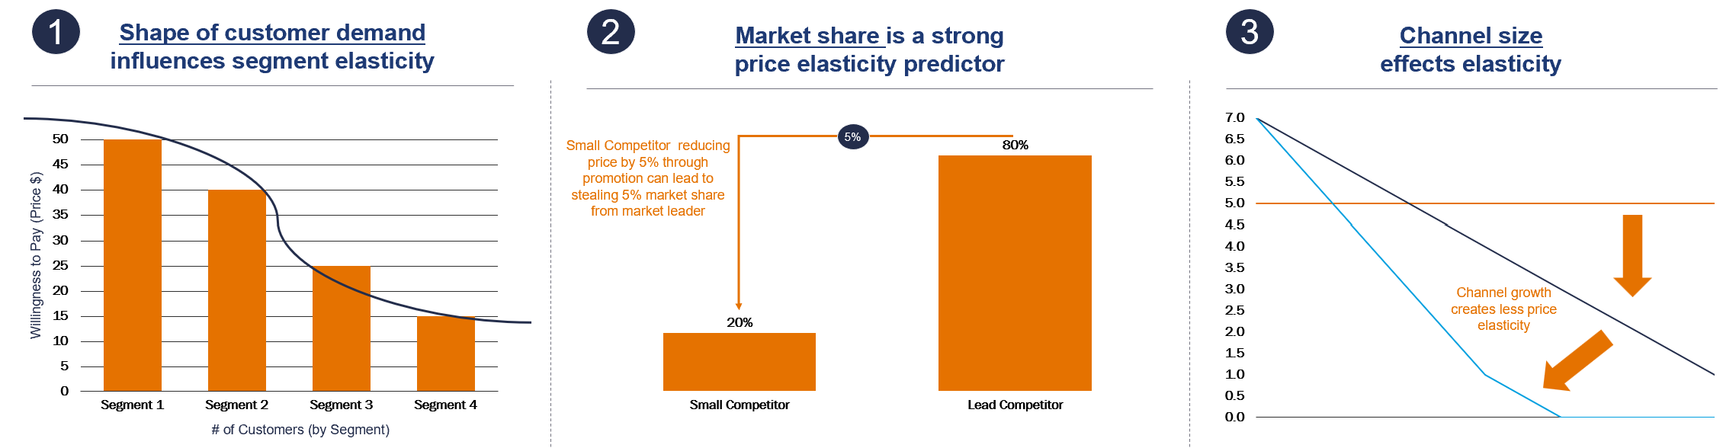
Retail Store Sales Prediction
Nidhi Shah | Shreyas Adiyodi | Ben Wilson
University Of Virginia
Darden School of Business
School of Data Science
Abstract
Materials and Methods
Results
This research paper highlights the teams use of the Cross-Industry Standard Process for Data Mining (CRISP-DM) approach to address the problem of accurately predicting future sales and customer demand for retail stores with over 3,000 drug stores in 7 European countries. The analysis assesses the impact of various factors such as promotions, competition, holidays, seasonality, and location on sales, and aims to minimize the Root Mean Square Percentage Error (RMSPE) while predicting store sales for six weeks. The exploratory data analysis highlights correlations, outlier stores, and seasonality, among other factors. Five baseline models are used for modelling, which are combined into a single ensemble model. The paper also includes additional qualitative insights to assist the stores in examining promotion and pricing strategies. These
insights focus on the three lenses to pricing
and psychological factors that influence
human nature when shopping while
providing suggestions on how to utilize
customer value drivers, assess customer
demand and propensity to purchase, react
to potential competitor pricing models, and understand customers level of involvement with the purchase process.
Through exploratory analysis, our team revealed several key insights. First, there is a high positive correlation between customers and sales, which indicates that attracting and retaining customers is crucial for driving sales. Additionally, holidays have a strong negative correlation with sales due to closures (similar to Sunday’s), with no noticeable sales increase prior to the holiday. Furthermore, competition features have little impact on sales.
In addition, we identified significant outlier stores in both sales and customers, with store type D consistently underperforming while store type B well outperforms other stores. Seasonality naturally plays a role in sales, with dips in June and November, yet increases in August and December. Regarding promotions, we found that promotion 2 (consecutive promotions) is ineffective as fewer sales occur, while promotion 1 is effective for increasing sales significantly. However, we need to verify on a per-item basis whether promotion 1 truly increases overall profitability, as sales increases may offset profit decreases per item. We also observed that promotions have become predictable to customers, resulting in a sales dip before promotions and after promotions. Finally, we noted that competition has increased both in number and in proximity to the stores, underscoring the importance of monitoring and responding to competitor pricing and promotions.
To predict sales, we utilized modern machine learning principles to develop predictive models while minimizing the Root Mean Square Percentage Error (RMSPE). To accomplish this, we created five baseline models using linear regression, decision tree, random forest, xgb model, and light gb model. Each of these models had their own strengths and weaknesses, but by combining them into a single ensemble model, we were able to take advantage of each model's strengths while minimizing the risk of any model's bias.
The linear regression model was chosen as a baseline because it is simple and interpretable. However, it is limited in its ability to capture complex relationships in the data. The decision tree model, on the other hand, is able to capture complex relationships, but can be prone to overfitting. The random forest model helps to mitigate this by aggregating the results of multiple decision trees. The xgb model and light gb model are both gradient boosting models that perform well in predicting complex nonlinear relationships.
By combining these models, we were able to develop a more robust and accurate prediction model. In addition, the ensemble approach also helped us to identify which features were most important in predicting sales. By analyzing the feature importance of each model, we were able to identify the key drivers of sales and optimize our predictions accordingly.
The model performance greatly enhanced as more robust methods were applied to the sales prediction problem. Linear Regression was primarily ineffective in its prediction. The Decision Tree produced a moderate prediction with a public score of 0.26695, although utilizing Random Forest for an additional tree method saw an enhancement to 0.22736. As we moved to more gradient based methods, they appeared initially less effective with XGB producing a score of 0.3014, although Light GB produced the optimal score of all models used for a score of 0.13938.
Given that Light GB had the best score of the models produced, it was given the highest of weights to use for the Ensemble model, determined by a further Linear Regression against the model outputs when regressed on the true sales output. In stacking these models with the appropriate linear weights for the Ensemble, it produced a score of 0.2236. Although not an optimal score, it has the strength of being less biased to the training data than each individual model (including the Light GB) and may enhance its predictive power as further training data is applied in the future and the input models are continuedly enhanced and refined.
Conclusion
Background
For the Kaggle competition, the Light GB model should be submitted due to its enhanced performance is minimizing RMSPE to predict future sales. For the drug store company, a more ensemble approach should be leveraged to minimize any current model bias that may be present if one were to only use the current Light GB model. As additional data is added, further refinement should be performed to verify the model weighting remains optimal.
The datasets provide valuable insights into the factors that influence sales and customer behavior in a retail setting. In this study, our team followed the CRISP framework to fully understand the business problem while developing quantitative insights to predict future sales. Through exploratory data analysis on the dataset, our aim was to understand the impact of various factors on sales and customer behavior in order to make informed decisions that can help improve business performance. Specifically, we drew enhanced focus on the promotions that were scheduled to determine if the optimal promotion schedule was conducted to increase sales and, by extension, store profitability. Extrapolating beyond the current prediction problem, the larger question as to how stores should predict
sales and space promotions is a common
question. It was our goal to develop a
model with deep insights that could be
used across a greater population of retail
or non-retail clients in the future. Such
research is focused beyond the current
Store population but also how one should
think about and respond to competitors
offering similar promotions in a highly
competitive marketplace.
Future Direction
To gain insights into pricing and promotion strategies, the stores should consider a range of qualitative factors. Firstly, to analyze customer demand curves and take into account local market share and channel size when determining how promotions and pricing should be approached. Secondly, identify the customer value drivers that are relevant to different segments to gain a better understanding of customer demand and their propensity to purchase. Thirdly, how to react to potential competitor pricing models and how their competitors might respond to their own promotion strategy. Finally, level of involvement and visibility customers incorporate into their buying behavior should be
evaluated, as this has an
impact on the utility they
receive in both positive
and negative interactions.

